Slide 1
Food Delivery Analysis
An end-to-end business intelligence study utilizing ChatGPT dataset generation, Power Query pipelines, advanced DAX modeling, and interactive Power BI dashboards.
Data Cleaning & Prep Saad Shaikh
DAX & Analysis Rechal Parshee
Dashboard & UI Soham Deshmukh

Slide 2

Team Roles & Project Stack
Responsibilities & Execution
Technology Tools Applied
➔
Saad Shaikh: Dataset ingestion, structure alignment, duplicate elimination, and missing value handling via Power Query.
➔
ChatGPT: Prompt-engineered initial food delivery ordering logs and synthetic customer transaction datasets.
➔
Rechal Parshee: Data modeling, time-intelligence DAX formulation, and statistical relationship definitions.
➔
Power Query: Automated ETL pipeline to cleanse data types, column names, and missing attributes.
➔
Power BI & DAX: Analytical calculation engine creating measures for real-time executive dashboard decision-making.
➔
Soham Deshmukh: UX visual architecture, KPI widget configuration, and final Power BI dashboard publishing.

Slide 3





Data Ingestion & Preprocessing
1. Dataset Generation
2. Power Query Pipeline
3. Schema Optimization
Generated raw food delivery data via ChatGPT simulating real-world order IDs, order dates, cities, delivery times, customer ratings, and restaurant categories.
Imported dataset into Power BI Desktop. Purged duplicates, sanitized null values, and standardized text casing across categorical columns.
Converted date-time formats and numeric types. Created clear dimension mappings for Cities, Categories, and Restaurants ready for DAX logic.

Slide 4

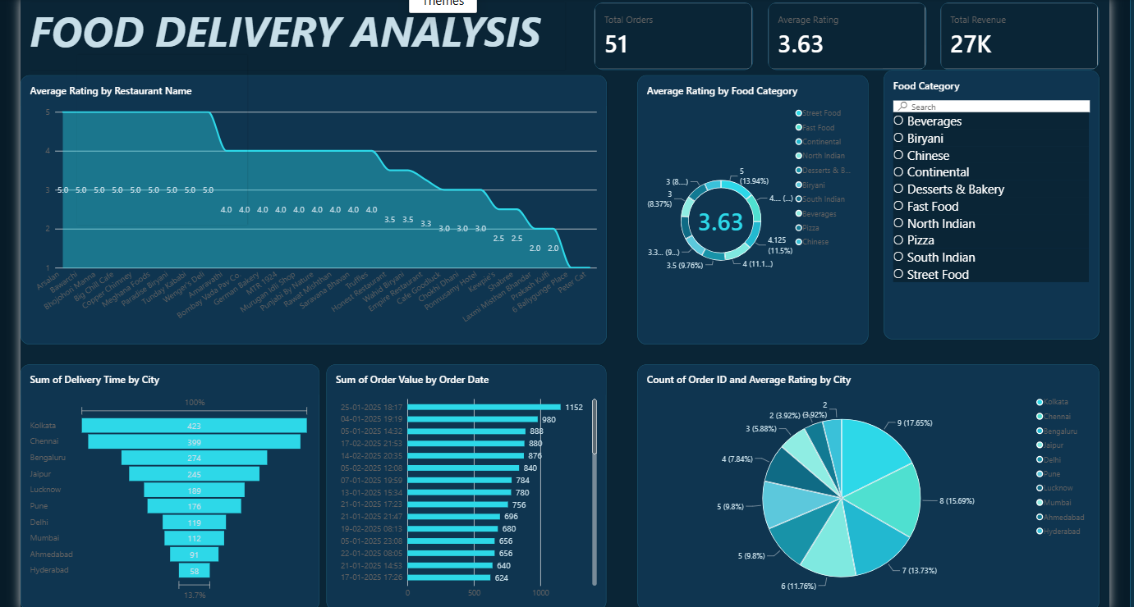
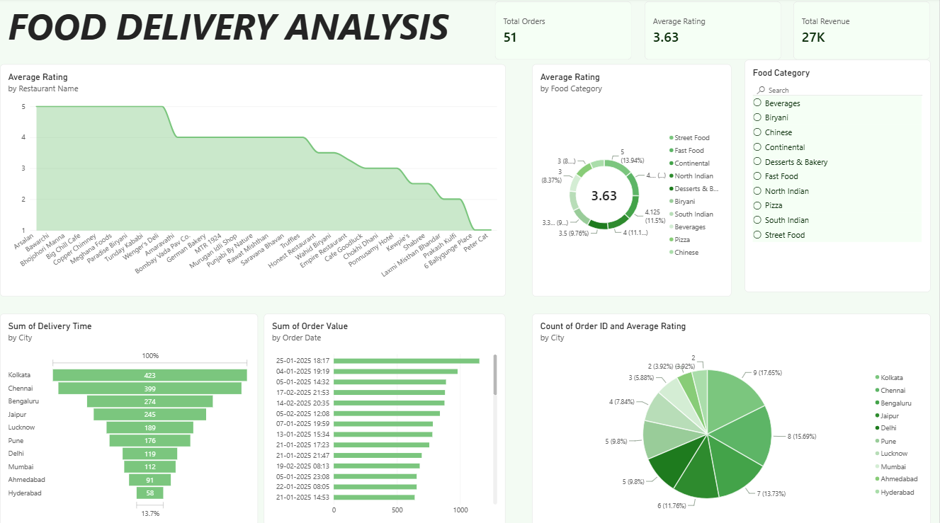
Interactive Power BI Dashboard

Slide 5

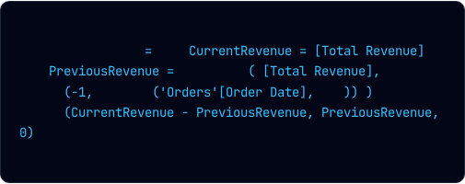
DAX Measures & Logic
Key Performance Measures
Time Intelligence DAX
Custom DAX formulas were designed to monitor operational performance metrics dynamically across slicers:
Revenue Growth % formulation using VAR offset windowing:
➔
Total Orders: Count of unique Order IDs (`COUNT(Orders[Order ID])`).
Revenue Growth %
VAR
VAR
CALCULATE
OFFSET
ORDERBY
ASC
RETURN
➔
Total Revenue: Aggregate sales (`SUM(Orders[Order Value])`).
DIVIDE
➔
Average Delivery Time: Mean transit time in minutes.
➔
Average Rating: Customer satisfaction score out of 5.

Slide 6






Executive Metrics Summary
Operational Baseline
Total Orders Processed
Total Generated Revenue
The primary KPI indicators synthesized across the food delivery ordering dataset showcase key business volumes and average fulfillment scores.
Average Rating (out of 5)
Major Cities Covered

Slide 7
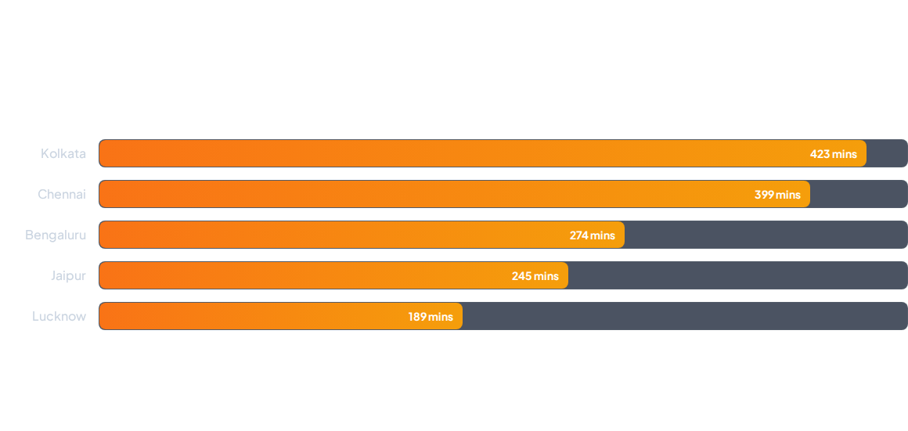
Delivery Time by City
Cumulative delivery fulfillment duration (in minutes) across top metro regions analyzed in Power BI:

Slide 8

Order Share by Geography
Top Regional Hubs
Kolkata: 9 Orders (17.65%)
51
Chennai: 8 Orders (15.69%)
Total Orders
Bengaluru: 7 Orders (13.73%)
Jaipur & Lucknow: 12 Orders (23.5%)
Other Cities: 15 Orders (29.4%)

Slide 9
Power BI Model Schema
Field Name | Data Type | Role / Structure | Business Context
Order ID | Text / Key | Primary Dimension | Unique transaction code for tracking
Order Value / Revenue | Decimal Currency | Fact / Aggregation | Base measure for Total Revenue ($27K)
Delivery Time | Integer (Minutes) | Fact Metric | Logistics speed tracking across cities
Rating | Decimal (1.0 - 5.0) | Fact Metric | Customer feedback score calculation
Revenue Growth % | Percentage Measure | DAX Time Intelligence | Period-over-period revenue change

Slide 10
Questions & Answers
Thank you for reviewing our Food Delivery Analytics presentation built with Power BI, Power Query, and DAX.
Saad Shaikh
•
Rechal Parshee
•
Soham Deshmukh

